Slide 1
EDPM
Level 2

Slide 2

Manuscripts
Area of focus:
  What is a manuscript
  Manuscript Abbreviations
  Headings
  Manuscript Correction signs

Slide 3
Manuscript
A manuscript is the original written or typewritten work of an author that is used to prepare a mailable or printable document.
A manuscript Contains:
  Abbreviations that must be spelled out
  Correction symbols or marks that must be interpreted and applied.

Slide 4
Abbreviations
An abbreviation is a shortened form of a word or phrase.
  When writing a document, an author may use abbreviations or contracted words to save time.
  Some abbreviations are commonly used. While some can be made up by the user.

Slide 5
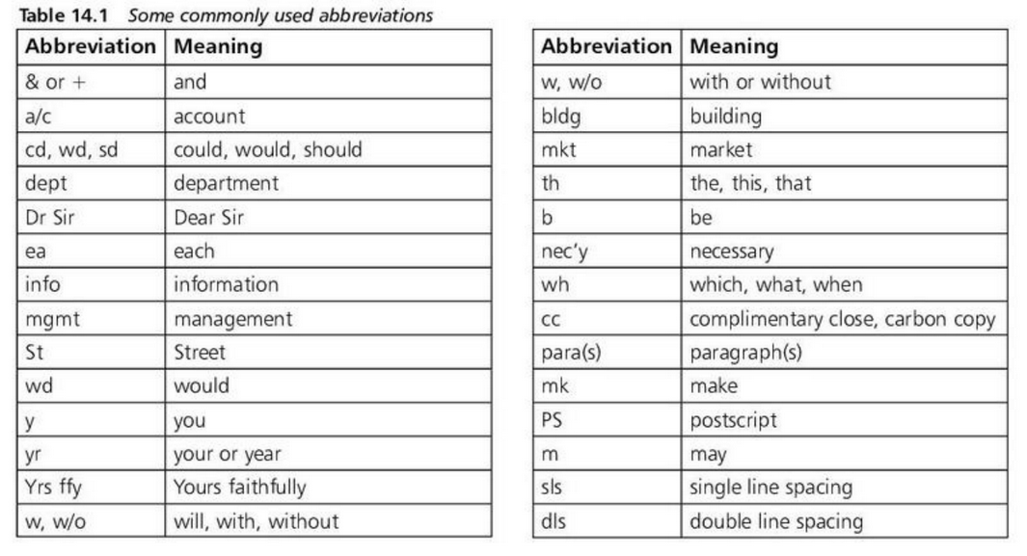
Abbreviations
Commonly used abbreviations

Slide 6
Headings
A heading is a group of text that indicates the topic of documents.
  There are several types of headings, with specific formatting rules governing each heading.

Slide 7
Types of Headings
Main heading
Subheading
Shoulder heading
Paragraph heading
Marginal heading

Slide 8
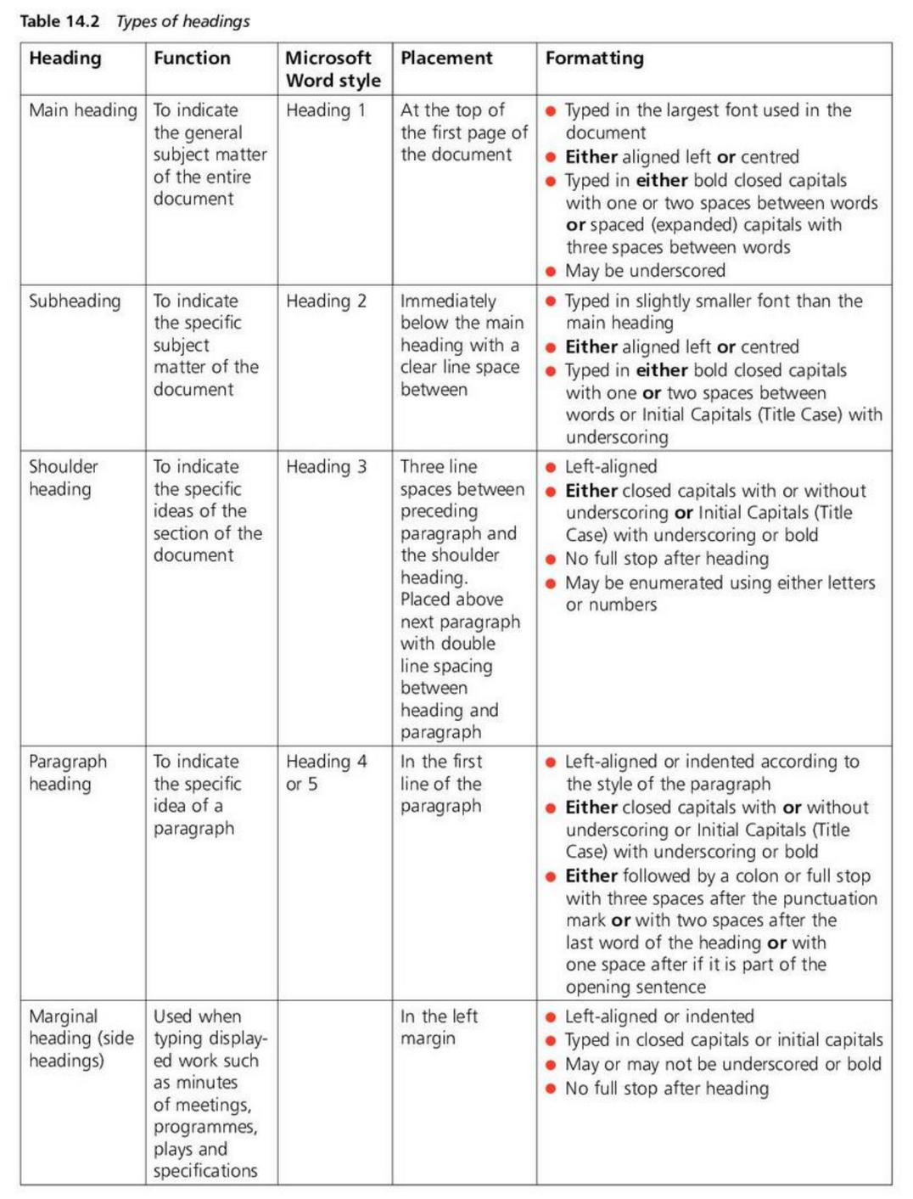
Types of Headings

Slide 9
Manuscript Correction Signs
Manuscript correction signs are a standard set of signs and symbols used to indicate corrections on proofs.
  These marks are placed both in the text and in the margin.

Slide 10
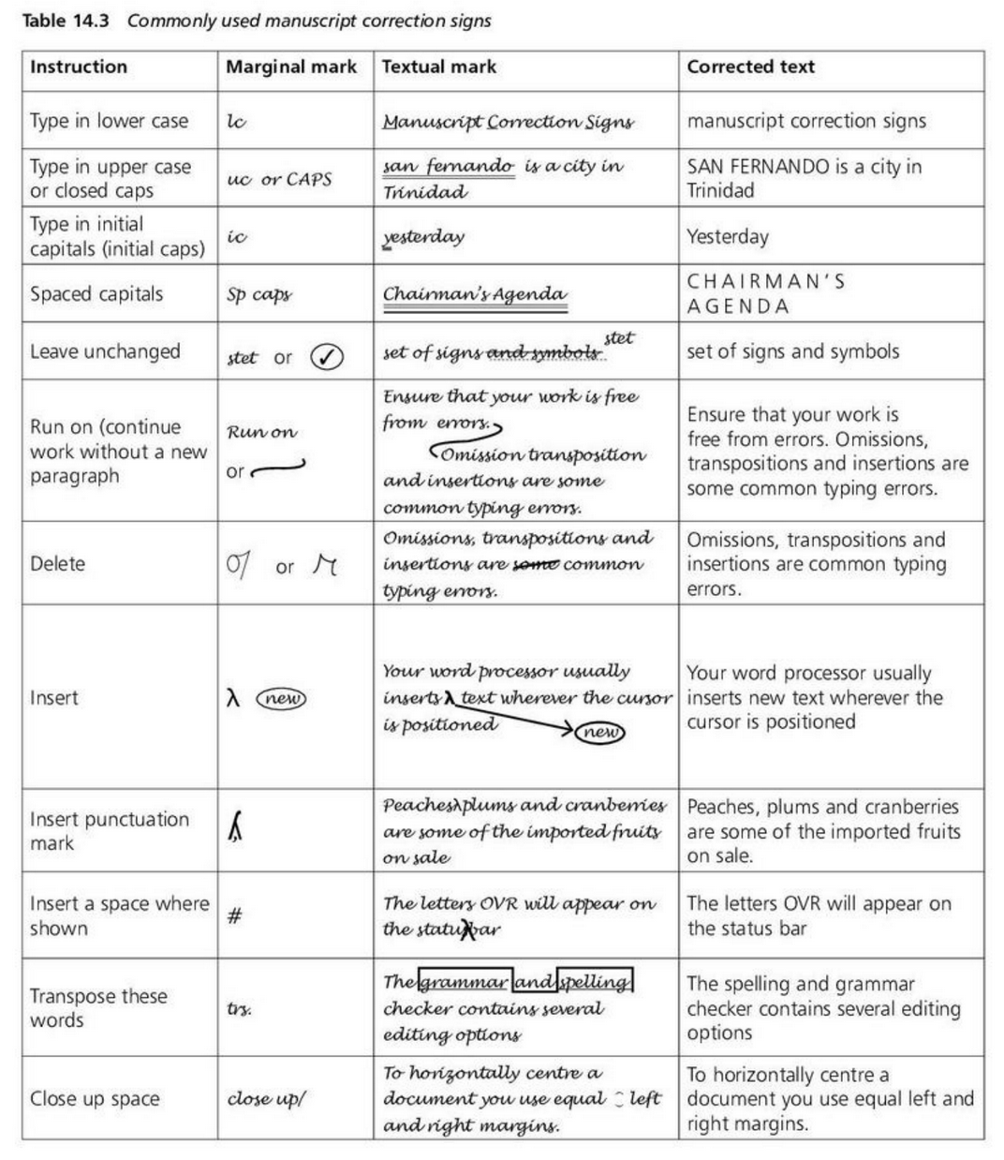
Manuscript correction sign

Slide 11
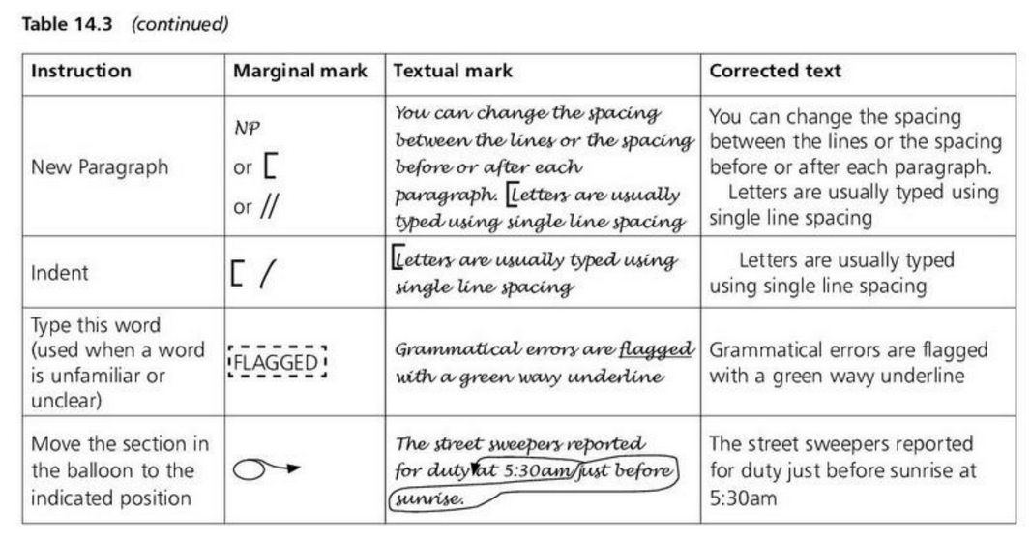
Manuscript correction sign

Slide 12
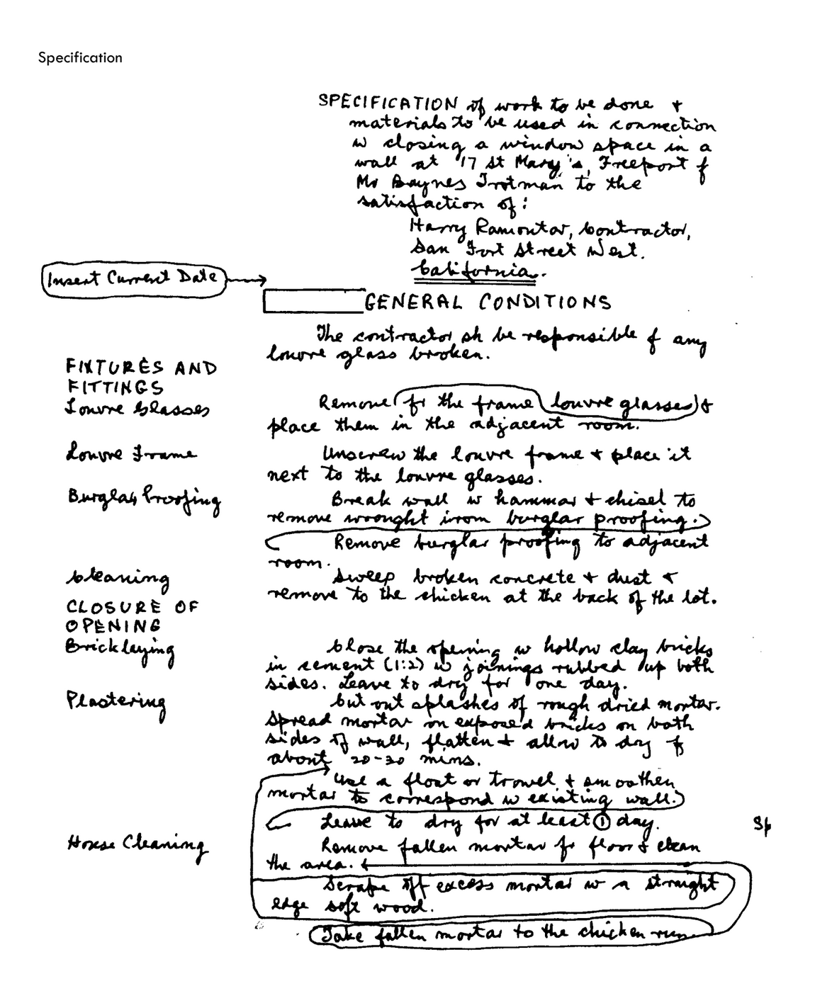
Manuscript SBA Sample
Complete and email to chenry@stgeorgesinstitute.org
Due Date: 12/17/2021

Slide 13
Resources
Heading: https://www.youtube.com/watch?v=u2ParAPCHTY
Sample Block style manuscript: https://www.youtube.com/watch?v=oLQ1JyIHJOc
Manuscript: https://www.youtube.com/watch?v=3V1wiPdT99g

