Slide 1
Data Communication and Networking

Slide 2
Objectives:
Define Data communication
Components of Data Communication

Slide 3
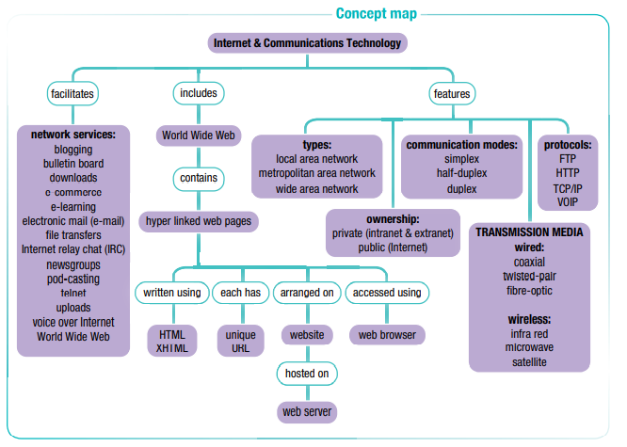
Concept Map:

Slide 4
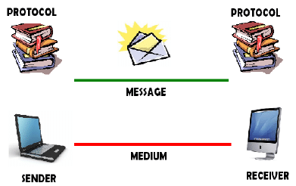
Data Communication:

Slide 5
Data Communication:
Data communication is the transfer of information from one computer to another.
In data communications, one computer (the sender or transmitter) transfers data to another computer (receiver) over a communication channel or communication link.
This channel or link may be wired or wireless.
When the receiving computer is located distance away from the sending computer, we say that the receiving computer ‘is remotely located’.

Slide 6
Data Communication:
Transferring of data is referred to as:
  Uploading
  Downloading
Uploading is the transferring of a file from one computer to another computer on a network using data communication.
Downloading is transferring a copy of a file from a distant computer to a disk in one’s local computer using data communication

Slide 7
Data Communication:
A network is a communications, data exchange and resource-sharing system created by linking two or more computers, using established standards or protocols so that they can work together.
  When computers are connected via communication channels, users can share hardware resources, data files and programs we have a network.

Slide 8
Data Communication:
Types of networks:
  Local area networks (LANs)
  Metropolitan area networks (MANs)
  Wide area networks (WANs)

Slide 9
Data Communication:
Types of networks:
Type of Network
Local area networks (LANs) | A network that uses cables or radio signals to link two or more computers in a geographically limited area (generally one building or a group of buildings). School, university, office etc.
Metropolitan area networks (MANs) | Regional computer or communication network spanning the area covered by an average to large-sized city. (1 or more LAN connected)
Wide area networks (WANs) | A data communication network extending a LAN (local area network) outside its building, over telecommunication lines or wirelessly, to link to other LANs over great distances. The Internet is an example of a WAN

Slide 10
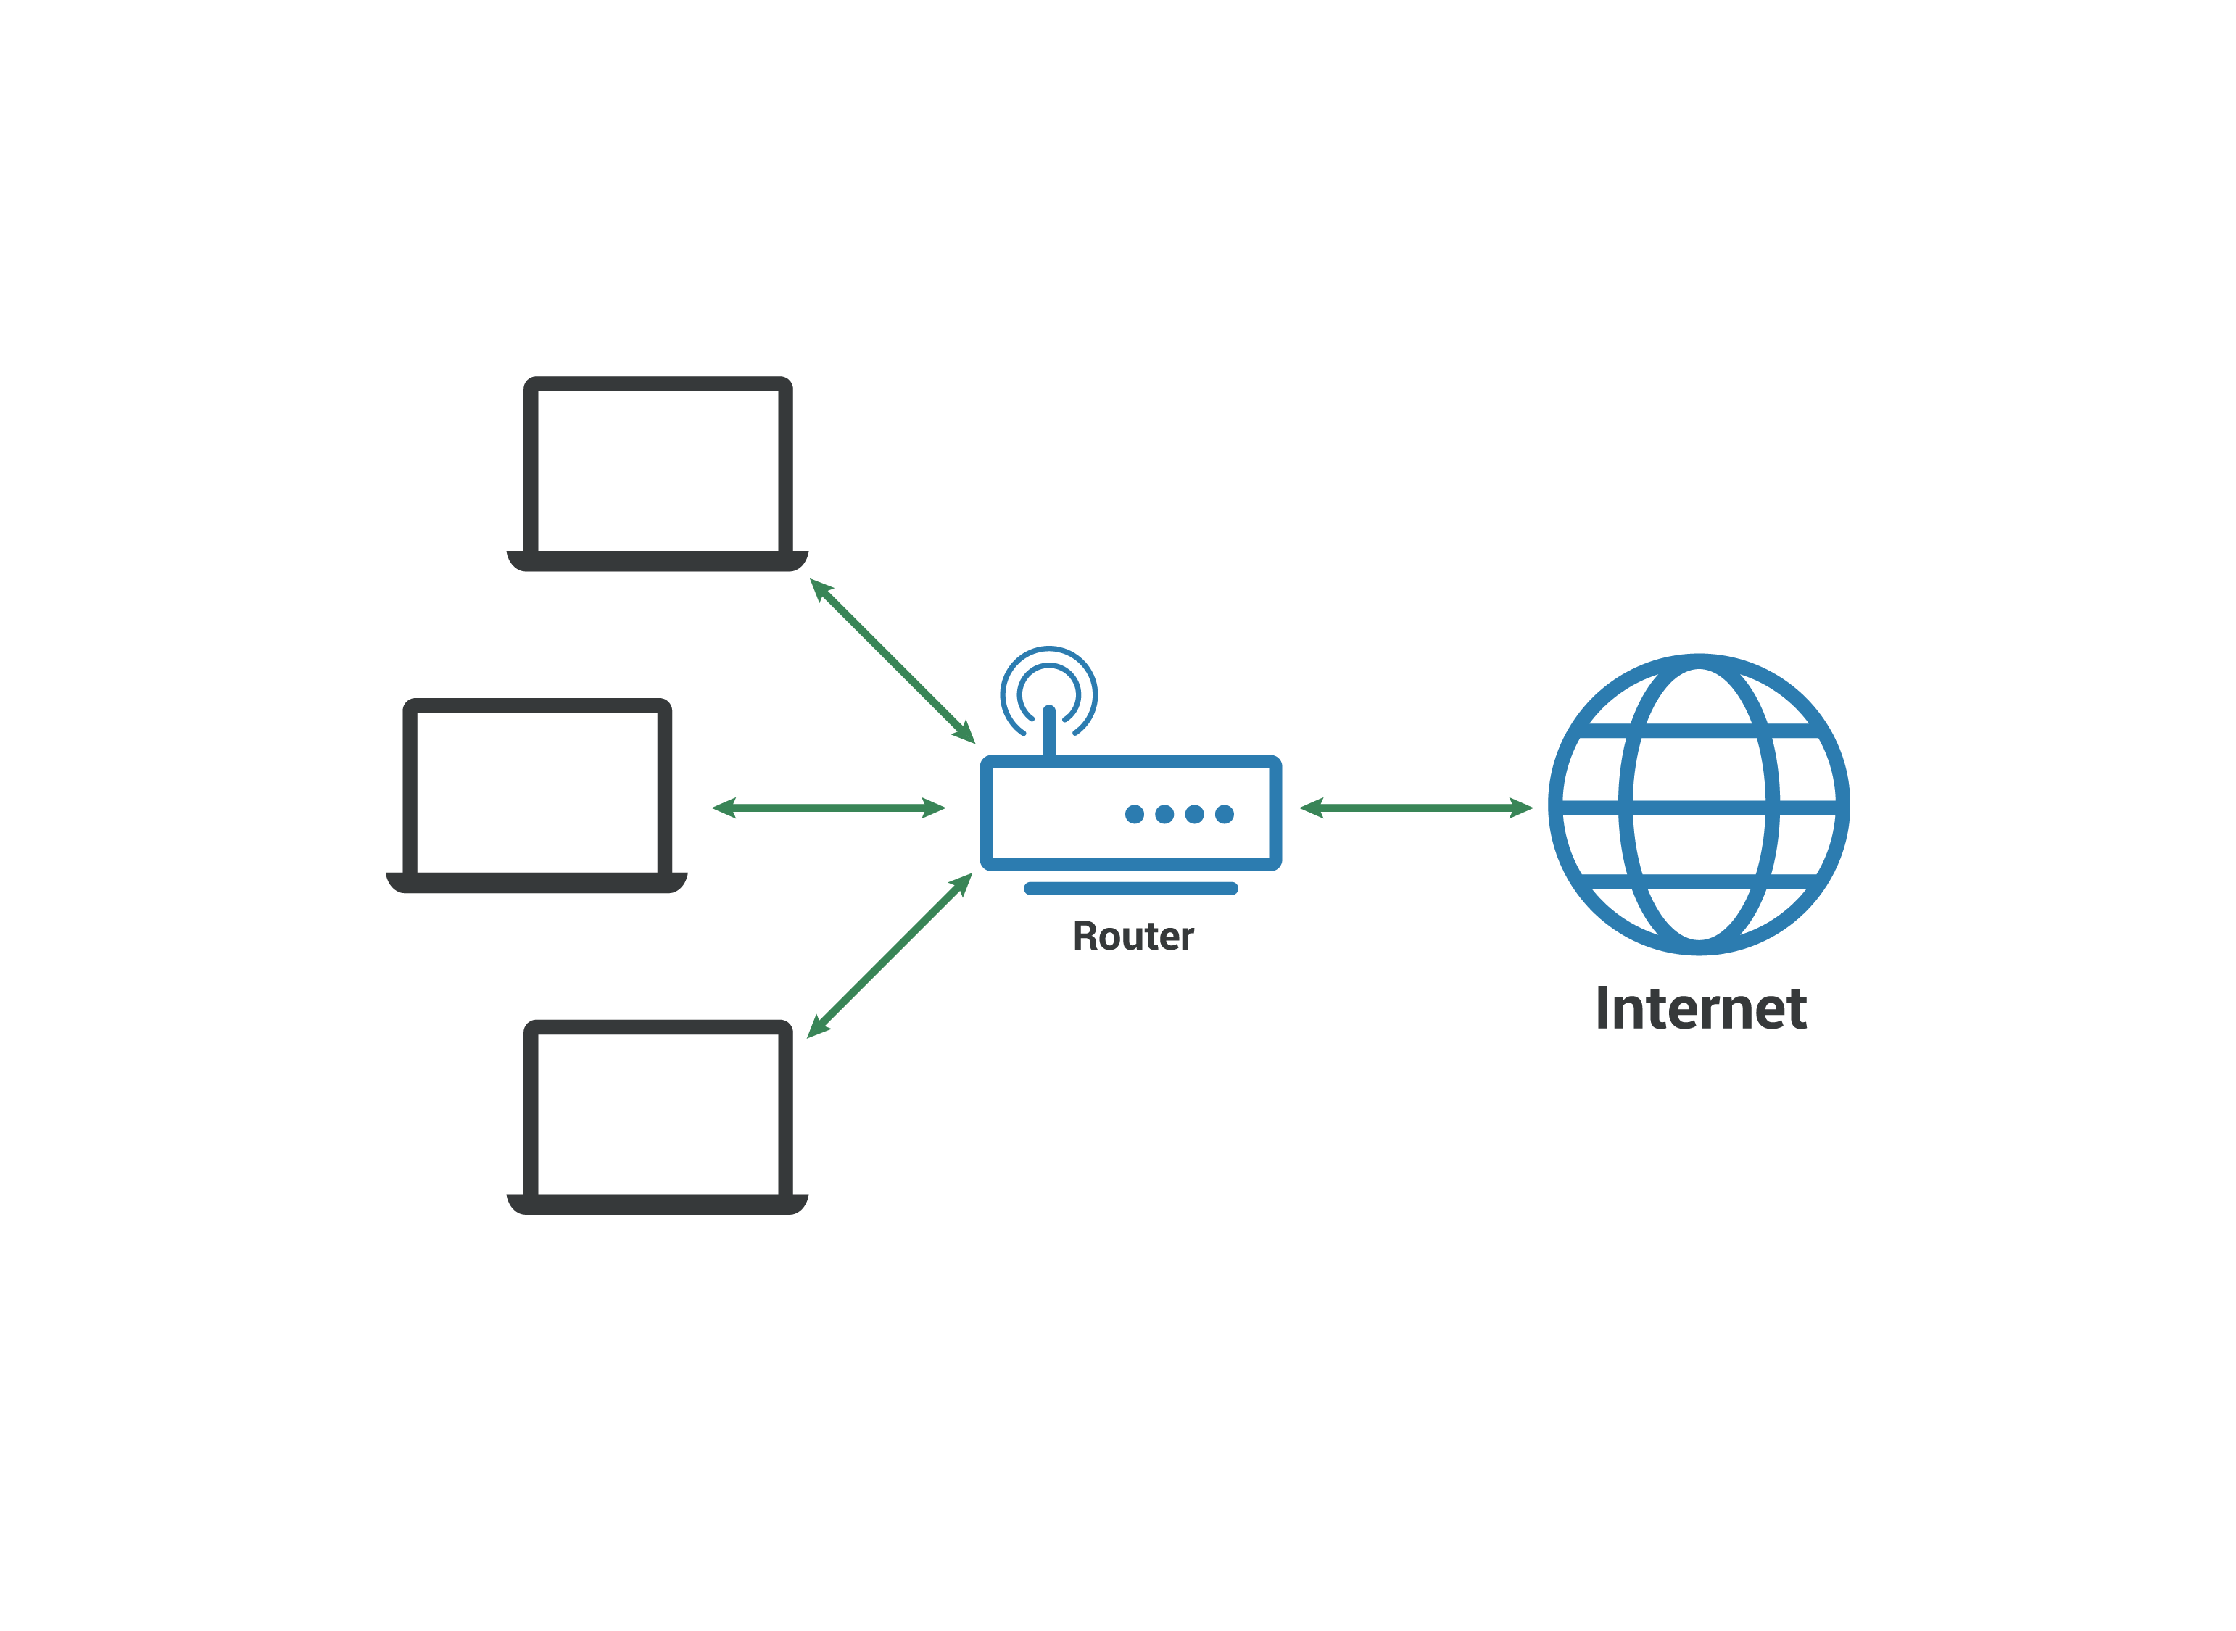
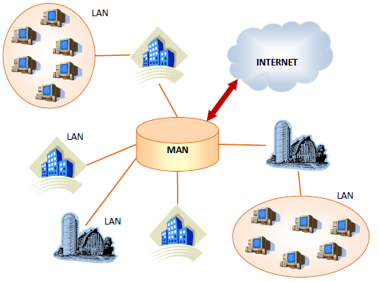
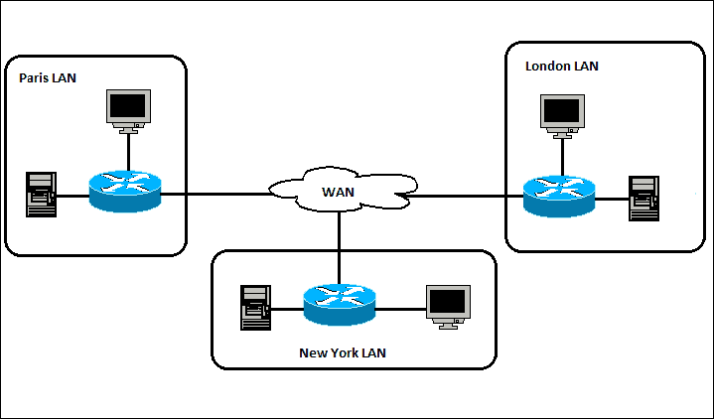
Data Communication:
Types of networks:
WAN
Lan
MAN

Slide 11
Data Communication:
Networking hardware
A range of hardware devices are used to connect computers together to create networks.
These include:
Network cards - Each network card has a socket into which a special cable fits
Hubs - A hub is just a device that connects many cables together and transfers network messages between those cables.
Switches – mediator between two device, message from one computer is dispatched to it’s destination by the switch
Routers – The gateway of a network

Slide 12
Data Communication:
Networking hardware
Difference Between a Hub, switch and Router

Slide 13
Data Communication:
Types of Transmission media:
1. Cables are referred to as wired media.
  Coaxial
  Twisted pair
  Fiber-optic cables
2. Radio waves are referred to as wireless media or simply wireless,
  Satellite
  Microwave
  Infrared.
  Bluetooth
  Wi-Fi (wireless fidelity)

Slide 14
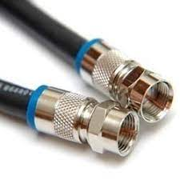
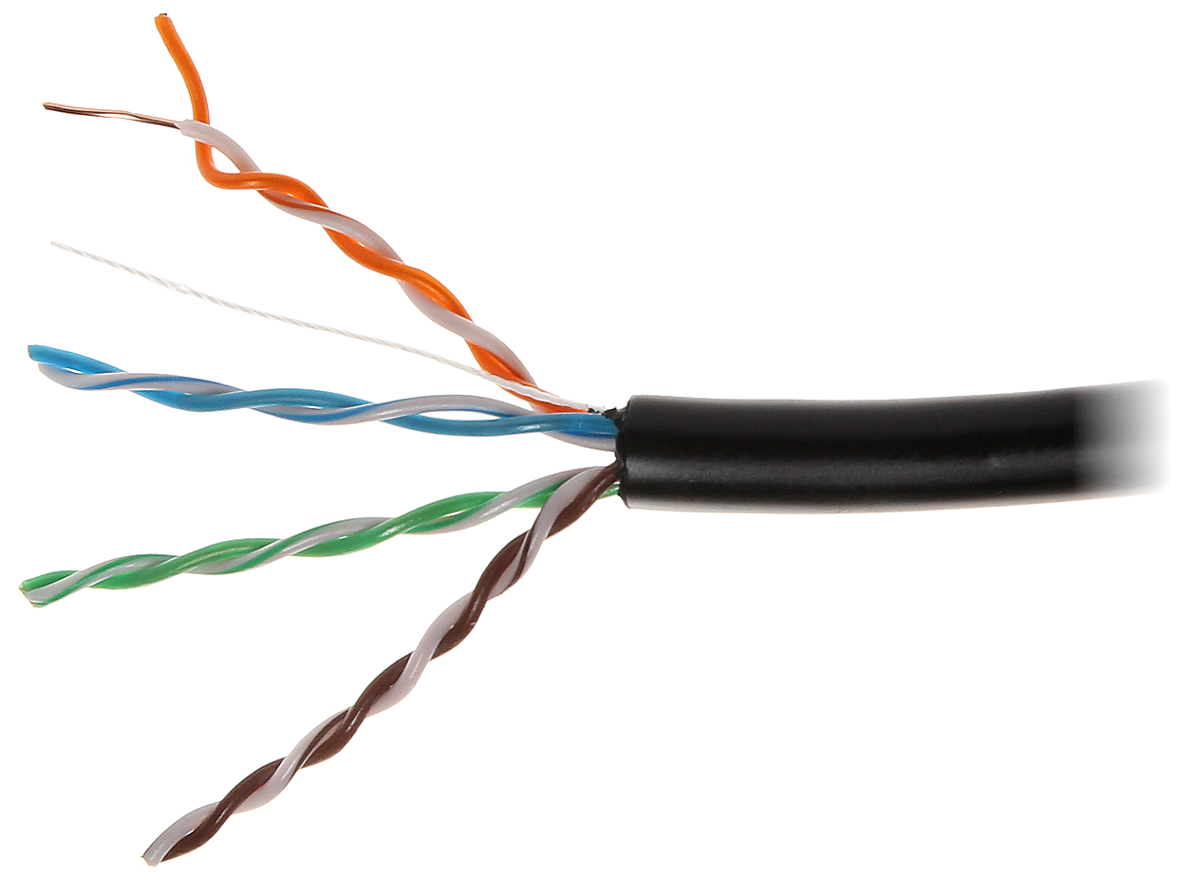
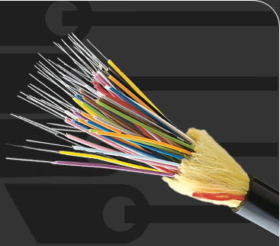
Data Communication:
1. Cables are referred to as wired media.
  Coaxial
  Twisted pair
  Fibre-optic cables
  Coaxial
  Twisted pair
  Fibre-optic

Slide 15
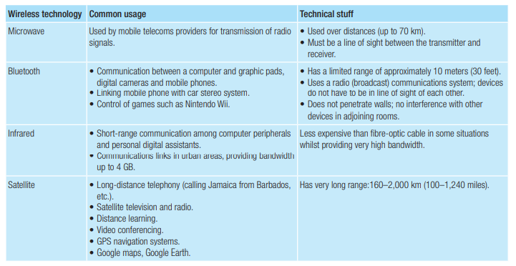
Data Communication:
Wireless media:

Slide 16
Data Communication:
Bandwidth - the speed at which each transmission media carry data.
Bandwidth
Types of Bandwidth:
Narrowband
Voiceband
Broadband.

Slide 17
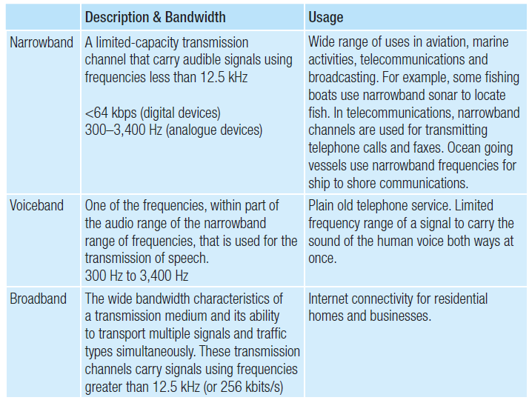
Data Communication:
Bandwidth

Slide 18
Data Communication:
Communication modes – Computers communicate/communication modes via:
Broadcast
Point-to-point
Broadcast - sending out a message to all the other computers on a network.
  Radio and television stations broadcast their programs
Point-to-point, however, establishes a direct communication channel between two computers on a network.
  A Cell phone, a wireless path is created between the two callers. Other people in the vicinity are unable to receive the call.

Slide 19
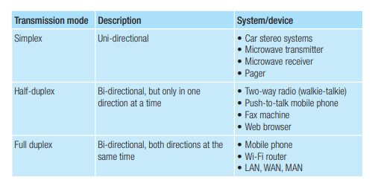
Data Communication:
Data travels over a transmission medium in one of three ways:
  Simplex
  Half-duplex
  Full duplex.

Slide 20
Data Communication:
The Internet, intranet and extranet:
The Internet is a public, global (wide area) network based on the TCP/ IP protocol.
  The TCP/IP protocol assigns every connected computer a unique Internet address, also called an IP address, so that any two connected computers can locate each other on the network and locate data.
An intranet is a private computer network designed to meet the needs of a single organization or company that is based on Internet (TCP/IP) technology.
  It is not necessarily open to the external Internet and not open to outside users.
An extranet is an intranet that has been selectively opened to specially selected individuals or organizations (including customers, suppliers, research associates).
  An online banking application is an example of an extranet.

Slide 21
Data Communication:
Internet concepts:
Data communication via the Internet, a global wide area network, is based on the TCP/IP protocol. Communication with the World Wide Web is based on another protocol:
  HTTP
  FTP
  VoIP
  Wi-Fi
  Bluetooth

Slide 22
Data Communication:
Internet concepts:
Hyper Text Transfer Protocol (HTTP) is a protocol used to request and transmit files, especially web pages and web page components, over the Internet or other computer networks.
File Transfer Protocol (FTP) is a protocol used to transfer files between FTP servers and clients.

Slide 23
Data Communication:
Internet concepts cont’d:
Voice over IP (VoIP) is the use of Internet-based technologies to transmit voice-grade data over the Internet.
As more people connect to the Internet with fast broadband connections, it has become possible to use the Internet for voice communication.
Companies are now using IP-based phone systems (by Cisco and Avaya) instead of the conventional service offered by telecommunication companies.
Skype and Google Hangout also facilitate VoIP

Slide 24
Data Communication:
Internet concepts cont’d:
Bluetooth is a wireless protocol for exchanging data over short distances from fixed and mobile devices, using radio waves.
Bluetooth capability is enabled in a device by means of an embedded Bluetooth chip and supporting software.
The chip enables Bluetooth to be built into a wide range of devices such as cellular phones and PDAs.

Slide 25
Data Communication:
Internet concepts cont’d:
Uses of the Bluetooth protocol include:
Wireless control of and communication between a cell phone and a handsfree headset
Wireless control of and communication between a cell phone and a Bluetooth compatible car stereo system
Wireless Bluetooth headset and intercom
Wireless networking between PCs in a confined space and where little bandwidth is required
Wireless communication with PC input and output devices, the most common being the mouse, keyboard and printer
Transfer of files, contact details, calendar appointments, and reminders between smartphones.

Slide 26
Data Communication:
Internet concepts cont’d
Wi-Fi is a marketing term created by the Wi-Fi Alliance, a non-profit industry group that tests products to ensure that they comply with industry wireless standards.
These standards relate to a range of protocols governing wireless LAN communications.

Slide 27
Data Communication:
The World Wide Web (WWW) - is a huge collection of documents called web pages.
These web pages are grouped into websites, stored on web servers, downloaded, and displayed on a user’s computer by a web browser.
A web page is a document, written in Hyper Text Markup Language (HTML), that may contain text, sound, images, video clips, hyperlinks and other components.
A website is a group of web pages that belong together and are linked to each other using hyperlinks.
Organizations want viewers to be able to find documents on their website easily, so they arrange their website to have a single-entry point from which the rest of the website is accessed; this is the organization's home page.

Slide 28
Data Communication:
Website Cont’d
One of the main features of HTML is the ability to convert an item of text into a hyperlink. This hyperlink serves as a navigational scheme that allows users to browse from one web page to another or from one website to the next.
Each hyperlink contains the full address of another web page so clicking on the hyperlink has the same effect as typing the full address in the web browser.
When a hyperlink is clicked, the web browser downloads and displays the new web page.
Hyperlinks are like shortcuts to other web pages.
A hyperlink is an icon, information object, underlined or otherwise emphasized word or phrase that displays another document (or resource) when clicked with the mouse.

Slide 29
Data Communication:
A web server is special-purpose application software that accepts requests for information, framed according to the Hyper Text Transport Protocol (HTTP), processes these requests and sends the requested document.
A web browser is special-purpose application software that runs on an Internet- connected computer and uses the HTTP to connect with web servers.
  All web browsers can decode web pages that have been written (marked) with HTML.
  A web browser is needed for a web page to be requested, downloaded, decoded and displayed on a user’s local machine.
The most common web browsers are:
Internet Explorer
Firefox
Chrome
Safari
Opera.

Slide 30
Data Communication:
A uniform resource locator (URL) is a string of characters that uniquely identifies an Internet resource’s type and location.
Consider the following URL: http://www.amazon.com/Apple-iPad-Mini-Black-16GB/
  http:// – identifies a World Wide Web protocol.
  www.amazon.com – www. indicates a resource on the World Wide Web
  amazon indicates the Internet domain name
  .com indicates the domain suffix.
  Apple-iPad-Mini-Black-16GB/ – fully describes the directory structure (where the document is stored) and includes the document’s name and extension.
Many companies use their company name as part of their Internet domain name. This makes it easier for users to find the website using search engines.
A top-level domain name is the last part of an Internet domain name, that is, the group of letters that follow the final dot of any Internet domain name, ‘com’ in our example above

Slide 31
Data Communication:
Communicating globally using network-based tools:
E-mail Electronic mail (e-mail) applications allow users to send an electronic message over a network to anyone with an e-mail address and access to a computer system.
An e-mail address is always in the form:
  username@domain_name, for example, info@macmillan-caribbean.com.
Common desktop e-mail application programs include:
  Evolution Mail
  Outlook
  Outlook Express.
Free web-based e-mail accounts include:
  Gmail – Yahoo Mail
  Hotmail - Microsoft
  Yahoo - Yahoo

Slide 32
Data Communication:
Communicating globally using network-based tools.
An e-mail message is usually text-based but may include images, sounds and video clips as attachments.
E-mail applications have similar functionality including the ability to read and store received messages, create and send new messages.
Messages can be sent to one or more recipients.
Facilities to maintain an address book or contacts list are also usually provided. This makes it quicker and easier to send e-mail to the correct recipients.
The delivery of e-mail usually takes a matter of seconds, and, in the situation where delivery fails, the sender is advised accordingly.

Slide 33
Data Communication:
Communicating globally using network-based tools cont’d.
Internet relay chat (IRC) and instant messengers IRC is a messaging system that allows users to ‘chat’ with other people on the Internet using text messages.
Common IRC applications:
Yahoo Messenger
Google Talk
Kik
WhatsApp
These applications, must be installed on your smart device
Every user of the system has a unique ID (identification) that enables you to create a list of friends with whom you want to chat.
IRC is usually text chat; you type your comments and read the replies made by other people

Slide 34
Data Communication:
Communicating globally using network-based tools.
A bulletin board is an electronic forum that hosts posted messages and articles related to a common subject.
A newsgroup is an online discussion group or forum specifically focused on a particular area of interest.
Bulletin boards and newsgroups were popular before the Internet and WWW were created.
Users of the bulletin board would dial into the computer that hosted the bulletin board where they could read or leave messages.
They have largely been replaced by discussion forums on the WWW which have the same functionality, allowing users to post and reply to messages using a standard web browser.

Slide 35
Data Communication:
Communicating globally using network-based tools.
A blog or web log is a diary maintained by its author on the World Wide Web.
It allows users to comment on the posts.
People who used to maintain a diary of their daily activities started to make these entries, or posts, on their websites.
You do not have to have a website to maintain a blog as free blog hosting sites are available on the Internet.

Slide 36
Data Communication:
Communicating globally using network-based tools.
A podcast is an audio broadcast using the Internet that can be played back on an iPod or similar device.
Podcasts have become very popular with radio broadcasters, making their programs available online so listeners can catch up with any programs they might have missed.
Podcasts have now expanded, with smaller organizations producing their own podcasts only available on the Internet.

Slide 37
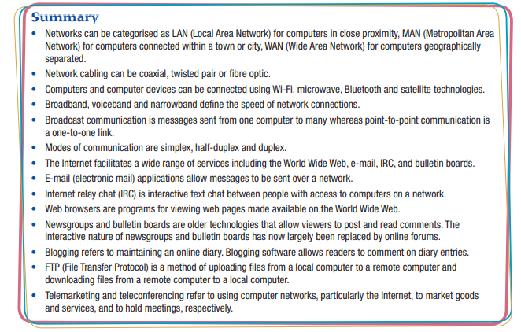
Summary:

