Slide 1

BUSINESS LETTERS
EDPM
TEACHER: J EMMONS

Slide 2
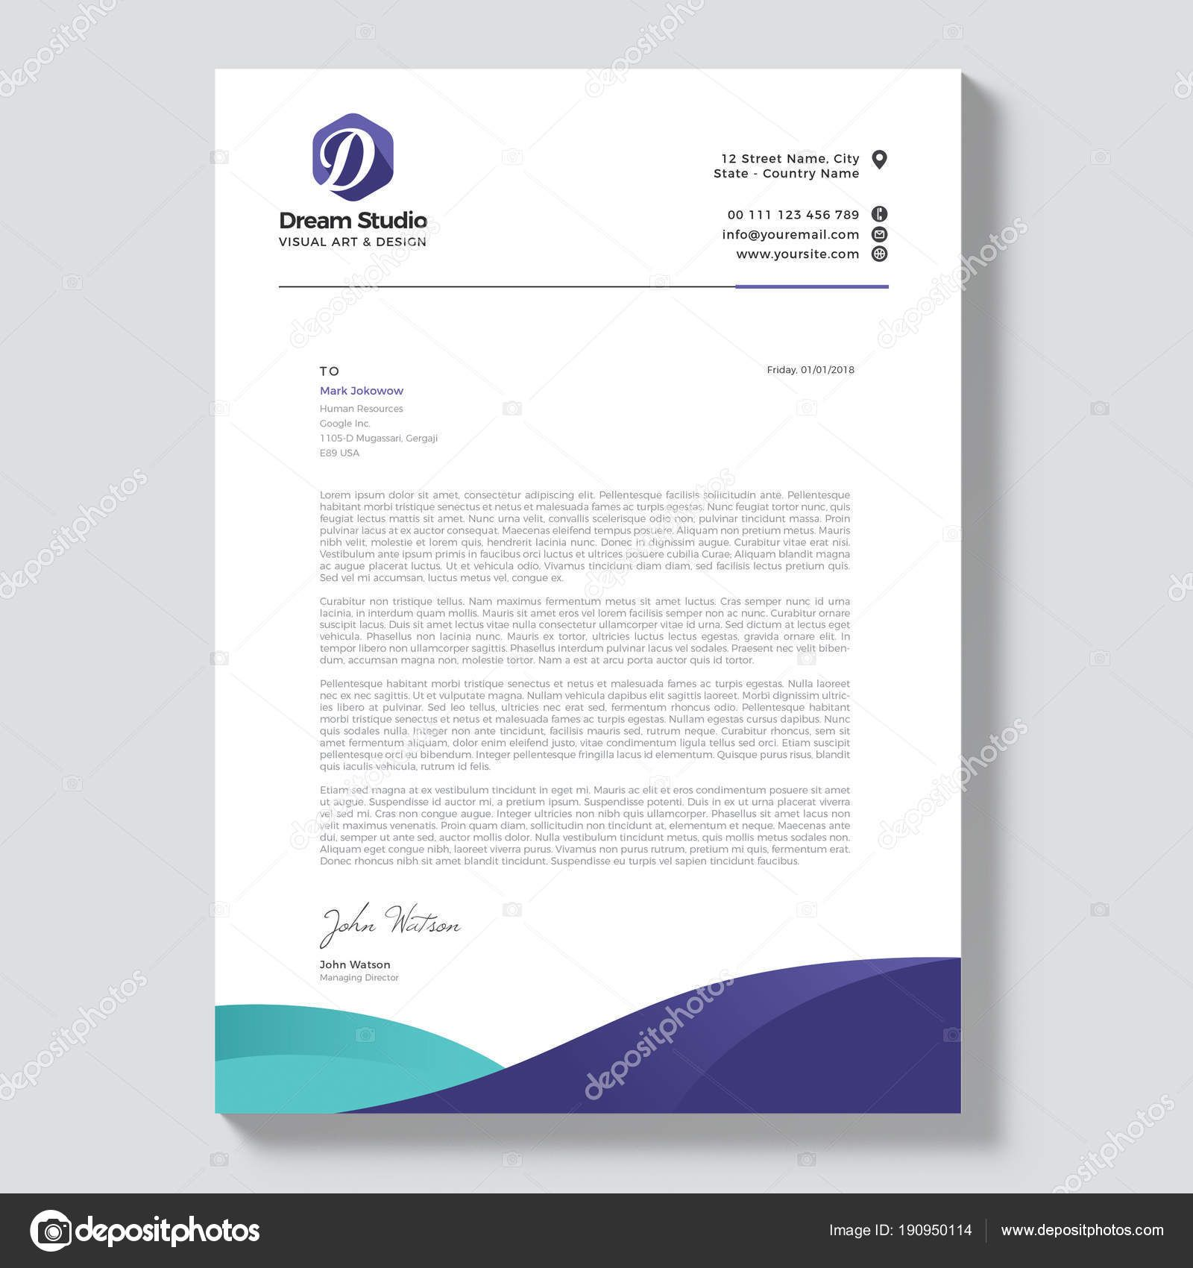
BUSINESS LETTERS
A letter is a written internal or external formal channel of communication between organizations, between organizations and individuals, between individuals.
Mailable standard – neat, free of error, accurate, quality paper.
A4 – long letters A5- short letters (1 page)

Slide 3
BUSINESS LETTERS
Setting margins for letter
A4 paper
Top margin - 1" start to type address/letterhead or 2" start to type reference to leave space for letter head.
Side – 1 to 1.5" left and 1" right in line with letterhead or reference on letterhead.
Bottom - at least 1"

Slide 4
BUSINESS LETTERS
Setting margins for letter
A5 paper
Top - 0.5" or 1" start (1.5" - space for letterhead)
Side – 1 or 0.75" left and 1 or 0.5" right
Bottom - at least 1"

Slide 5
BUSINESS LETTERS
Parts of a letter
1 or 2 clear line spaces (DS/TS)
A business letter consists of the following parts in the order in which they appear:
Letterhead (Sender’s name and return address) 1.5 to 2’’ (H)
Also Include:
Company name
Logo
Telephone
Email address
Fax number
Website
Directors names

Slide 6
BUSINESS LETTERS
Parts of a letter
Set 1.5 to 2’’ (Height)
Letterhead (Sender’s name and return address)
Name of person/company – font size 14 (Font can be adjusted)
Address – font size 12
Contact details – font size 10
Insert logo (text wrap to move easily) – same height as text and flush with the margin
May be centered
May insert a line

Slide 7
BUSINESS LETTERS
Parts of a letter
1 or 2 clear line spaces (DS/TS)
Reference – this usually consists of the initials of the writer of the letter and those of the typist, e.g. PAW/JS, typed against the words ‘Our ref’. Alternatively, the reference may include details of a file number, or customer’s account number, e.g. PAW/200764/Acc/JS.
You should always include a reference showing the writer’s initials and your own, unless you are asked not to do so. The reference shown on any incoming letter should be included in the letter of reply against the words ‘Your ref’.

Slide 8
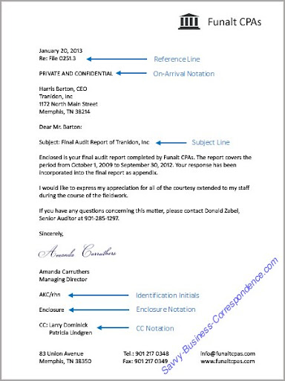

Slide 9
BUSINESS LETTERS
Parts of a letter
1 or 2 clear line spaces (DS/TS)
Date – the date must always be typed on a letter, even if you are not given instructions to include it.
The date should be typed in the following order:
Blocked – day, month and year, no comma, with the name of the month in full.
Semi-blocked and Indented – Month, day, comma and year, with name of month in full.

Slide 10
BUSINESS LETTERS
Parts of a letter
Special Instructions (Mailing or addressee notation) – any special instructions, such as PERSONAL, PRIVATE, CONFIDENTIAL, etc, should be typed above the name and address of the recipient. Leave at least 1 clear line space between the special instruction and the name and address.

Slide 11
BUSINESS LETTERS
Parts of a letter
1 or 2 clear line spaces (DS/TS)
Attention line – some business organizations like all correspondence to be addressed to the company rather than to individuals. In such cases it is usual to include an ‘attention line’ to ensure that the letter is directed to the appropriate department or individual. E.G.
FOR THE ATTENTION OF MRS B WILMOT, SALES DEPARTMENT

Slide 12
BUSINESS LETTERS
Parts of a letter
1 or 2 clear line spaces (DS/TS)
Inside name and address (Recipient’s name and address) – the name and address of the individual or organization to whom the letter is being sent should always be included. These details are usually typed above the salutation (or attention line if any).
Each line of the address should start at the left margin. Use single-line spacing.

Slide 13
BUSINESS LETTERS
Parts of a letter
1 clear line (DS)
Salutation – the opening words of greeting in a letter are known as the ‘salutation’, and the forms used in business included the following.
Dear Sirs - Where the letter is addressed to a business/two or more males
Dear Sir (male/one person)
Dear Madam (one person/female)
Dear Sir/Madam (unknown gender of receiver)
Dear Mr. Brown (know names of addressee)
Dear Ms. Wilson (unknown status)

Slide 14
BUSINESS LETTERS
Parts of a letter
1 clear line (DS)
Salutation
Dear Mrs. Clarke (married female)
Dear Miss Cone (not married)
Ladies (Two or more females of an organization)
Gentlemen (males of a club or association)

Slide 15
BUSINESS LETTERS
Parts of a letter
Salutation
Where the addressee's name in the inside name and address. (Note that the initial'(s) of the person's first name(s) is not included in the salutation)
      Dear John
      Dear Elizabeth - Where the addressee is well-known by the writer

Slide 16
BUSINESS LETTERS
Parts of a letter
Salutation (Informal)
Dear Mr. Smith
Dear Ms. Frank
Dear Customer

Slide 17
BUSINESS LETTERS
Parts of a letter
Subject Heading
A subject heading is sometimes used to help the reader identify the content rapidly, and to help in filing or in finding a particular letter in a correspondence file.

Slide 18
BUSINESS LETTERS
Parts of a letter
1 clear line spaces (DS)
Subject Heading
Leave one clear line space after the salutation before typing the subject heading,
may be typed in capitals with or without underscore, or in lower case characters with initial capitals and underscore.
Leave 1 clear line space after subject heading, before starting to type the main body of the letter.

Slide 19
BUSINESS LETTERS
Parts of a letter
1 clear line spaces (DS)
Body of the letter – the ‘body of the letter’ consists of the paragraphs of information, or the content of the letter. Single-line spacing is used for the paragraphs in the body of the letter, with a clear line space between paragraphs.

Slide 20
BUSINESS LETTERS
Parts of a letter
4-6 clear line spaces
Complimentary close – a short polite closing at end of letter. The most commonly-used form of complimentary close are:
Yours faithfully
Yours sincerely
Yours truly
Sincerely yours

Slide 21
BUSINESS LETTERS
Parts of a letter
Complimentary close
USED WITH SALUTATION
Yours faithfully’ should be used where the formal salutation ‘Dear Sir’ or ‘Dear Madam’ begins the letter (know the person)
Letters that start with a person’s name, e.g. ‘Dear Mr. Greene’, usually end with ‘Yours sincerely’ or ‘Sincerely yours’. ‘Yours truly’ may end a circular
letter.

Slide 22
BUSINESS LETTERS
Parts of a letter
Complimentary close
Very formal letters
Yours sincerely
Respectfully yours
Respectfully

Slide 23
BUSINESS LETTERS
Parts of a letter
Complimentary close
Informal letters
Best Wishes
Kindest Regards
Regards
Best Regards
Cordially

Slide 24
BUSINESS LETTERS
Parts of a letter
1 or 2 clear line spaces (DS/TS)
Name of organization – the name of the organization is often typed after the complimentary close, in capital letters (optional)
Signature of writer – the signature is, of course, usually handwritten by the person writing the letter, or the letter is signed by someone authorized to sign in place of the writer.

Slide 25
BUSINESS LETTERS
Parts of a letter
1 or 2 clear line spaces (DS/TS)
Signatory or Name of writer – because it is very difficult to decipher some signatures, it is usual to type the name of the person signing the letter. Leave at least 4 clear line spaces below the complimentary close and the name of the writer to allow for the signature.
Designation or Job title and department – should be typed immediately below the name.

Slide 26
BUSINESS LETTERS
Parts of a letter
1 or 2 clear line spaces (DS/TS)
Enclosure notation/Attachment – attention is drawn to any material to enclosed with the letter by typing an ‘enclosure notation’. (check if mentioned in body of the letter)
Where a single item in enclosed, the abbreviation ‘Enc’ or ‘Att’ should be typed at the end of the letter, at least 2 clear line spaces below the name and/or job title.

Slide 28
BUSINESS LETTERS
Parts of a letter
Enclosure notation/Attachment
Where there are several enclosures, type ‘Encs’ or alternatively the number of enclosures may be included, e.g. ‘Encs-3’. Some organization like the nature of the enclosure to be indicated, e.g. ‘Enc – Production Report’.

Slide 29
BUSINESS LETTERS
Parts of a letter
1 or 2 clear line spaces (DS/TS)
Copy notation – A courtesy copy notation (showing the distribution of the letter) appears two lines below the enclosure notation and flush with the left margin. Cc, cc:, Copy to, Copies to,
All people receiving the letter in addition to the addressee are listed:
cc Edward Albers
G.C. Fischer
Merilee Tobias

Slide 30
BUSINESS LETTERS
Parts of a letter
1 or 2 clear line spaces (DS/TS)
Postscript - Postscripts (additions to a handwritten letter after it has been typed or items needing emphasis) appear 1 or 2 lines below the last line of courtesy copy notation.
The use of the initials PS or PPS is optional.

Slide 31
BUSINESS LETTERS
Punctuation style of a letter
Open punctuation - punctuation marks are completely omitted except in the body of the letter.
      Example: 157 Uplift Boulevard
      Cheerful Road
      Mountain Pen P O
      Kingston

Slide 32
BUSINESS LETTERS
Punctuation style of a letter
Full punctuation - all necessary punctuation marks are used.
      Example:
      157 Uplift Boulevard,
      Cheerful Road,
      Mountain Pen P. O.,
      Kingston

Slide 33
BUSINESS LETTERS
Layout of a letter
There are three main styles of layout in the current use of business letters:
  Fully blocked
  Semi-Blocked
  Indented

Slide 34
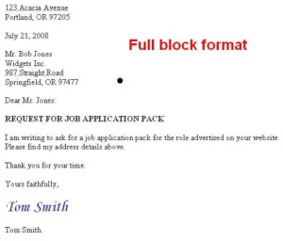
  FEATURES
  All elements are left-aligned
  with margin
  Open punctuation
  Used continuation page for two-page letters (include page number, recipient and date - top of page)

Slide 35
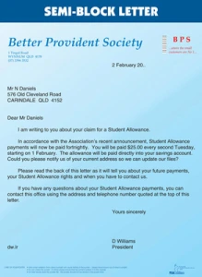
  FEATURES
  Sender’s address center or right-align if no letterhead is used
  Reference left aligned
  Date right aligned (same line as reference)
  Complimentary close, signatory and
  designation begins at center point
  All other elements left-aligned
  Closed or Full punctuation
  Used continuation page for two-page letters (include page number, recipient and date - top of page)

Slide 36
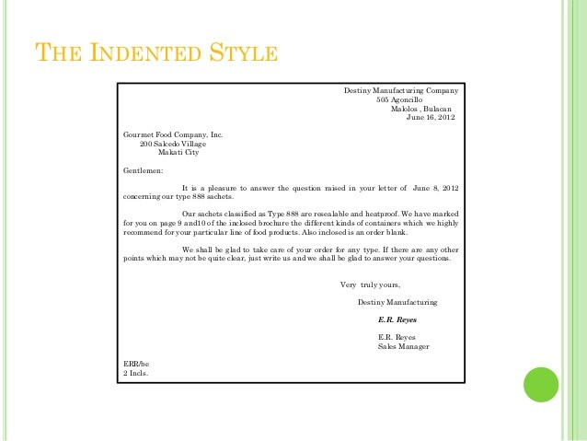
  FEATURES
  First lines of each paragraph indented
  Reference left aligned
  Date right aligned (same line as reference)
  Subject heading centered
  Sender's address, Complimentary close, Signatory and Designation are right-aligned
  Recipient's address, Salutation, Enclosures/copy
  notation/postscript left-aligned
  Closed or Full punctuation
  Used continuation page for two-page letters (include page number, recipient and date - top of page)

