Slide 1
Word Processing:
Footnote and Endnote

Slide 2
Objectives
Footnote and endnote
Adding Footnote and Endnote
Parts of a footnote and endnote
Inserting Footnote and endnote
Formatting footnote and endnote
Displaying footnote and endnote

Slide 3
Footnote:
Footnote - are used in printed documents to explain, comment on, or provide references for text in a document.
Endnotes – are used to cite sources of the information that was used in your document.

Slide 4
Parts of a footnote and Endnote:
The note reference mark – This is a number, letter, or symbol placed in the text to indicate that additional information is contained in a footnote or endnote
The note text – The footnote text appears at the bottom of the page whereas the endnote text appears at the end of the document or section.
Note separators – These are horizontal; lines that separate the .document text from the note text

Slide 5
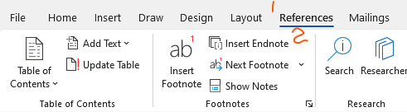
Inserting a Endnote:
Select the point in your document, where you would like to insert the note reference mark.
Reference
  Insert Endnote

Slide 6

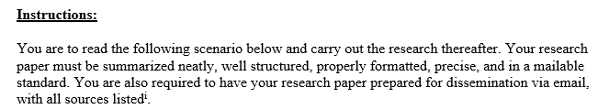
Inserting a footnote or Endnote:
Displayed at the end of your document
Number format displaying where the endnote is in your document.

Slide 7

Inserting a footnote or Endnote:
Select the point in your document, where you would like to insert the note reference mark.
Reference
  Insert Footnote

Slide 8


Inserting a footnote or Endnote:
Displayed at the bottom of your page/section
Number format displaying where the footnote is in your document.

Slide 9
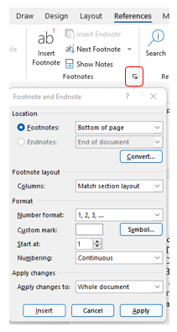
Formatting footnote or Endnote:
Use the dropdown arrow to format your footnote and endnote

Slide 10
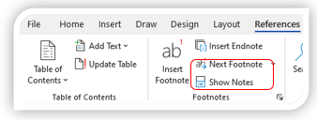
Displaying footnote or Endnote:
Show notes – displays the foot and end note at the bottom of the page/document
Next footnote/endnote – Navigate to the actual foot/endnote within the document

