Slide 1

Application Software

Slide 2
Objectives:
Students should be able to:
Define Application Software
List and define application subtypes
Uses of application software
Acquiring application software

Slide 3

Application Software
An application is a computer program designed to help people perform a certain task.
Depending on the work for which it was designed, an application can manipulate text, numbers, graphics, or a combination of these elements.

Slide 4

Subtypes of application software
Enterprise software
Information worker software
Educational software
Media development software

Slide 5

Subtypes of application software
Enterprise software - addresses the needs of organization processes and data flow, often in a large distributed environment.
Information worker software - addresses the needs of individuals to create and manage information, often for individual projects within a department.
Educational software - is a term used for any computer software which is made for an educational purpose. The purpose of all this software is to make some part of education more effective and efficient.
Media development software - addresses the needs of individuals who generate print and electronic media for others to consume, most often in a commercial or educational setting. (Creation of videos, audio, animation, sound graphics, text with a high degree of interaction)

Slide 6
Purpose of application software
A general-purpose software application is a software which has been designed to solve user's common or general tasks using a computer system.
Examples of General Purpose :
  Word processors
  Spreadsheets
  Photo editing applications
Special purpose application software is a type of software created to execute one specific task.
Examples of Special Purpose:
Camera application on your phone will only allow you to take and share pictures.
  Web browsers
  Calculators
  Media players
  Calendar programs

Slide 7
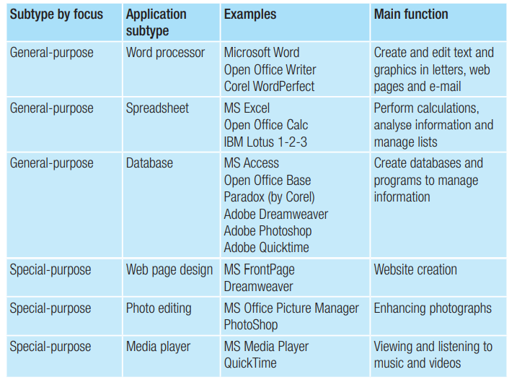
Purpose of application software

Slide 8
How are application software acquired?
Packaged
Custom-written
Customized Software

Slide 9
Packaged software:
Packaged software - is mass-produced, copyrighted software that meets the needs of a wide variety of users
Advantages:
Software is tailored to suit the needs of the user.
The user has close control over revisions and can modify the software as needed.
The program may run fast as the code is optimized for a specific purpose only

Slide 10
Custom-written or custom software
Custom-written or custom software is software that is created by programmers on behalf of a company to meet its unique requirements.
Disadvantages of developing custom software as compared with purchasing packaged software are:
It is more costly.
Longer development time; packaged software would be readily available.
It may have flaws during a period of initial use whereas packaged software would have been tested extensively.

Slide 11
Customized software
Customized software may be customized to a user’s liking through the selection of options or preferences, or the addition of components called add-ins.
Example:
A user may add-on modules to allow their spreadsheet package to perform some tasks automatically.

Slide 12
Bundling
Stand-alone program - is an application that is sold individually
01
Integrated software is a single program that contains a range of different functionalities.
02
Software suite - is a set of application programs that can be purchased together.
(Microsoft)
03

Slide 13
Advantages of integrated software vs multiple single-purpose applications:
It needs less space for installation as the software is installed as one application.
Data can be easily shared among applications using a range of built-in features.
Users get value for money as it costs less to purchase the integrated application rather than multiple packages.

Slide 14
Disadvantages of integrated software vs multiple single-purpose applications
The integrated software does not have all the features of the individual single-purpose applications..
Some integrated software packages do not include all the applications that may be required.

